Slide 1
Uncertainty
Chapter 13

Slide 2
不确定性
Let action A_{t} = leave for airport t minutes before flight
Will A_{t} get me there on time?
Problems:
  1) partial observability (road state, other drivers' plans, etc.)
  2) noisy sensors (KCBS traffic reports)
  3) uncertainty in action outcomes (at tire, etc.)
  4) immense complexity of modelling and predicting traffic
A₂₅ ？A₉₀ ？A₁₂₀ ？A₁₄₄₀ ？如何决策？

Slide 3
用概率决策！
Suppose I believe the following:
  P(A₉₀ gets me there on time | …) = 0.70
  P(A₁₂₀ gets me there on time | …) = 0.95
  P(A₁₄₄₀ gets me there on time | …) = 0.9999
Which action to choose?
  Depends on my preferences for missing flight vs. time spent waiting, etc.
Utility theory is used to represent and infer preferences
Decision theory = probability theory + utility theory
P(A25 gets me there on time | …) = 0.04

Slide 4
概率公理
For any propositions A, B
  0 ≤ P(A) ≤ 1
  P(true) = 1 and P(false) = 0
  P(A ∨ B) = P(A) + P(B) - P(A ∧ B)

Slide 5
几个名词
随机变量:样本空间上的实函数
Atomic event: a complete specification of the state of the world（说明每个随机变量的取值就可以了）
先验概率P(A)
后验概率（条件概率）P(A|B)
边际概率
  P(Y) = Σ_{z}P(Y, z)

Slide 6
  Conditioning
  P(Y) = Σ_{z}P(Y|z)P(z)
  Bayes’ Rule
  P(Y|X) = P(X,Y) / P(X) = P(X|Y) P(Y) / P(X) = =αP(X,Y)=αP(X|Y) P(Y)
  独立性
A and B are independent iff
P(A|B) = P(A) or P(B|A) = P(B) or P(A, B) = P(A) P(B)
  条件独立性
P(A ∧ B|C) = P(A|C)P(B|C)

Slide 7
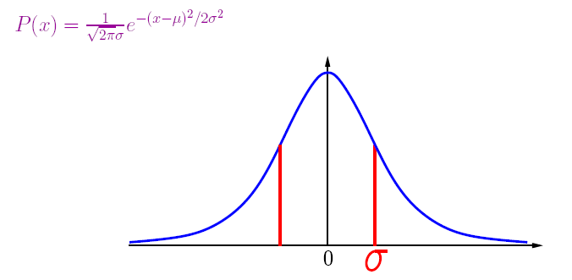
离散-连续型随机变量
离散-概率函数
连续-概率密度函数 pdf

Slide 8
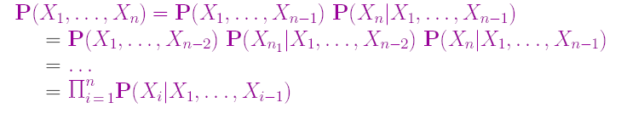
Chain rule

Slide 9
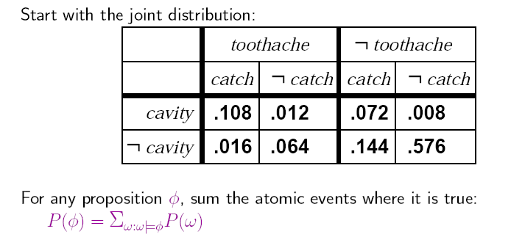
Inference by enumeration

Slide 10
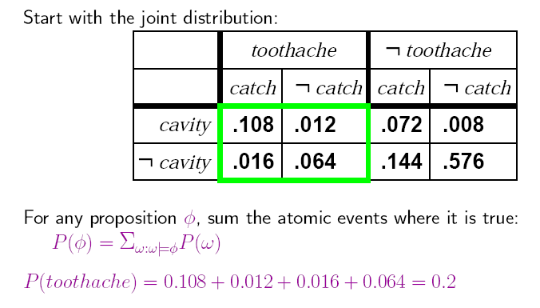
Inference by enumeration

Slide 11
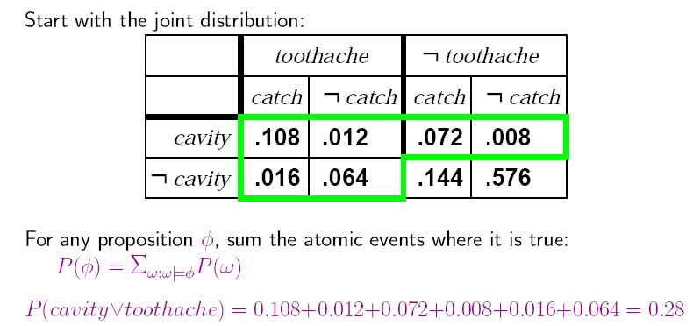
Inference by enumeration

Slide 12
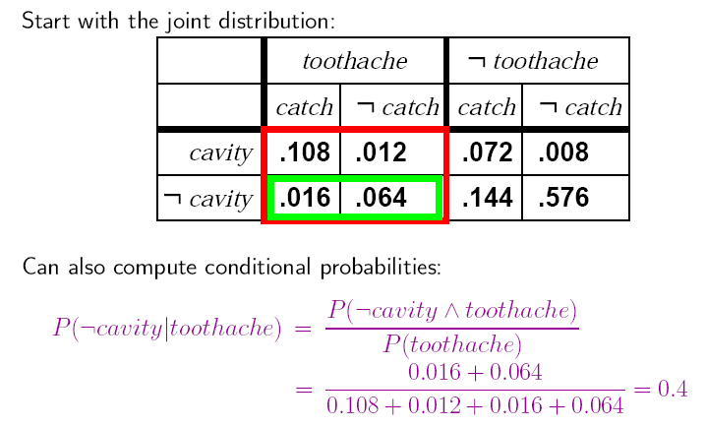
Inference by enumeration

Slide 13
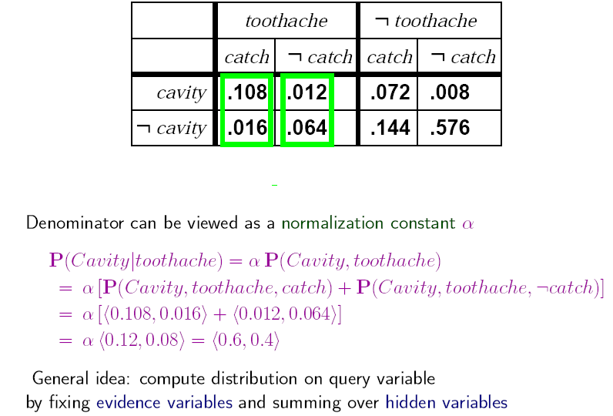
Inference by enumeration

Slide 14
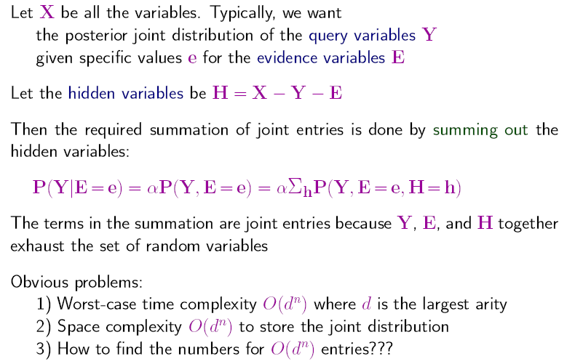
Inference by enumeration

Slide 15
利用独立性和条件独立性
  P(Toothache, Catch, Cavity, Weather)
  = P(Toothache, Catch, Cavity) P(Weather)
8×4 entries reduced to 8+4 (assume Weather has 4 values); for n independent biased coins, O(2^{n}) →O(n)
P(Toothache, Catch, Cavity)
  = P(Toothache | Catch, Cavity) P(Catch, Cavity)
I.e., 2 + 2 + 1 = 5 independent numbers
In most cases, the use of conditional independence reduces the size of the representation of the joint distribution from exponential in n to linear in n.
Conditional independence is our most basic and robust form of knowledge about uncertain environments.
  = P(Toothache | Catch, Cavity) P(Catch | Cavity) P(Cavity)
  = P(Toothache | Cavity) P(Catch | Cavity) P(Cavity)

Slide 16
贝叶斯法则运用
Useful for assessing diagnostic probability from causal probability:
  P(Cause|Effect) = P(Effect|Cause) P(Cause) / P(Effect)
  E.g., let M be meningitis, S be stiff neck:
    P(m|s) = P(s|m) P(m) / P(s) = 0.8 × 0.0001 / 0.1 = 0.0008
Note: posterior probability of meningitis still very small!

Slide 17
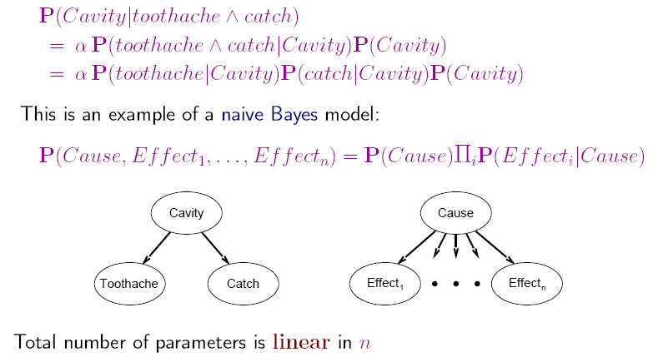
朴素贝叶斯模型

Slide 18
Monty Hall Problem
In September of 1991 a reader of Marilyn Vos Savant's Sunday Parade column wrote in and asked the following question:
"Suppose you're on a game show, and you're given the choice of three doors: Behind one door is a car; behind the others, goats. You need to guess behind which door the car is. You pick a door, say No. 1, and the host, who knows what's behind the other doors, opens another door, say No. 3, which has a goat. He then says to you, 'Do you want to pick door No. 2?' Is it to your advantage to take the switch?"

Slide 19


Monty Hall Problem
1
2
3
One Line Demo:
http://math.ucsd.edu/~crypto/Monty/monty.html

Slide 20
作业
13.18 Text categorization is the task of assigning a given document to one of a fixed set of categories on the basis of the text it contains. Naive Bayes models are often used for this task. In these models, the query variable is the document category, and the "effect" variables are the presence or absence of each word in the language; the assumption is that words occur independently in documents, with frequencies determined by the document category.
  a. Explain precisely how such a model can be constructed, given as "training data" a set of documents that have been assigned to categories.
  b. Explain precisely how to categorize a new document.
  c. Is the conditional independence assumption reasonable? Discuss.

